Slide 1


CROSS REGION REPLICATION DATA IN S3
PROJECT STUDENTS GUIDE
Benny Benjamin 411101186 Dr.A.MARY POSONIA M.E., Ph.D., Bright Sam 41110226 Professor and Head, CSE

Slide 2
AGENDA
Abstract
Objective(s)
Literature Survey
Inferences from Literature Survey
Proposed System
Modules Completed
Results and Discussion
Conclusion
References

Slide 3
ABSTRACT
Navigating unknown indoor environments is challenging for visually impaired individuals due to the absence of GPS and real-time obstacle detection. This paper presents an IoT-based navigation system using RSSI-based trilateration with ESP8266 and Dijkstra's algorithm for pathfinding. Haptic feedback via motor vibration intuitively guides users, while real-time data transmission using Socket.IO ensures dynamic path recalculations. An ESP32-CAM module detects obstacles for adaptive navigation, enhancing mobility and safety. This cost-effective, modular approach can be further improved with AI-based pathfinding and computer vision for greater independence.

Slide 4
OBJECTIVE(S)
The objective of this project is to develop an indoor navigation system for visually impaired individuals using beacon technology and YOLOv8-based object detection. It aims to provide real-time guidance, obstacle detection, and pathfinding assistance for safe and efficient mobility. The system enhances accessibility by leveraging machine learning to improve navigation accuracy in complex indoor environments.

Slide 5
Literature Survey (1/5)
S. A. Cheraghi, V. Namboodiri, and L. Walker [1] worked on creating GuideBeacon, a beacon-based indoor wayfinding system for the blind, visually impaired, and disoriented individuals. The system utilizes Bluetooth beacons and a smartphone app for real-time voice and tactile navigation, though it faces localization inaccuracies and compass dependency.
D. M. L. V. Dissanayake, R. G. M. D. R. P. Rajapaksha, U. P. Prabhashawara, S. A. D. S. P. Solanga, and J. A. D. C. A. Jayakody [2] proposed Navigate-Me, a secure, voice-authenticated indoor navigation system for blind individuals. The system integrates Bluetooth beacons and provides effective obstacle detection and real-time guidance, though it is limited to indoor use and faces accuracy issues in obstacle detection.

Slide 6
LITERATURE SURVEY(2/5)
D. M. L. V. Dissanayake, R. G. M. D. R. P. Rajapaksha, U. P. Prabhashawara, S. A. D. S. P. Solanga, and J. A. D. C. Anuradha Jayakody [3] developed Guide-Me, a voice-authenticated indoor user guidance system designed to assist visually impaired individuals. It incorporates Bluetooth beacons, localization, a smart stick with obstacle detection sensors, a machine-learning model for voice authentication, and secure server connection protocols for enhanced accessibility and security.
T. Ishihara, J. Vongkulbhisal, K. M. Kitani, and C. Asakawa [4] introduced a beacon-guided structure from motion system for smartphone-based navigation, improving feature matching and localization in complex environments. However, it requires the installation of BLE beacons, limiting deployment.

Slide 7
LITERATURE SURVEY(3/5)
S. L. Joseph, Chucai Yi, Jizhong Xiao, YingLi Tian, and Fei Yan [8] introduced visual semantic parameterization to enhance blind users' perception for indoor navigation. This system aids in creating a semantic schema for navigating indoor spaces.
Y. Keryakos, Y. B. Issa, M. Salomon, and A. Makhouly [9] proposed a hybrid navigation system aimed at providing stress-free indoor and outdoor mobility for blind users. By integrating real-time indoor and outdoor systems, the system detects stress levels and adjusts the route accordingly, with voice guidance and obstacle detection for safety.

Slide 8
LITERATURE SURVEY(4/5)
S. Mohan Kumar, V. Vishnudas Nemane, R. Raman, N. Latha, and J. Manojbhai Shah [10] introduced an IoT-BLE-based indoor navigation system for visually impaired people. This system provides real-time navigation assistance in indoor environments, though it is limited by beacon coverage and potential privacy concerns.
B. Li et al. [6] developed a vision-based mobile indoor assistive navigation aid for blind people, utilizing a semantic map of the indoor environment. It helps with path planning and real-time obstacle detection using RGB-D cameras and Kalman filters to estimate obstacle motion.

Slide 9
LITERATURE SURVEY(5/5)
L. Tian, Y. Tian, and C. Yi [5] proposed a method for detecting good quality frames in videos captured by a wearable camera to assist blind navigation. The system computes gradient and intensity statistics from frames and uses an SVM-based classifier to identify unblurred frames for extracting important navigation information.
W. Ye, N. He, J. Wang, and X. Yuan [7] presented a navigation system for guiding blind people both indoors and outdoors. The system uses computer vision, sensor fusion, voice feedback, and machine learning algorithms to enhance navigation in complex environments.

Slide 10
INFERENCES FROM LITERATURE SURVEY
Bluetooth Beacons: Systems like GuideBeacon and Navigate-Me use Bluetooth beacons, but face issues with localization accuracy and coverage in large areas.
Voice and Tactile Feedback: Voice and tactile systems (GuideBeacon, Guide-Me) aid navigation but struggle with accuracy in dynamic environments.
Hybrid Systems: Systems like Guide-Me and Hybrid Navigation combine Bluetooth, vision, and machine learning to improve navigation and obstacle detection.
Obstacle Detection Challenges: Real-time obstacle detection is integrated in systems like Guide-Me, but small or moving obstacles can still pose risks.
Indoor vs. Outdoor Navigation: Most systems focus on indoor navigation (Navigate-Me, GuideBeacon), with fewer solutions for seamless indoor and outdoor mobility.

Slide 11
PROPOSED SYSTEM (1/5)
The proposed indoor navigation system for visually impaired individuals integrates IoT-based localization, pathfinding, and object detection for real-time guidance. Using ESP8266 and ESP32 modules, it employs RSSI-based trilateration to estimate the user's position in indoor environments where GPS is unavailable. Dijkstra’s algorithm calculates the shortest path, dynamically updating routes when deviations occur.
Navigation guidance is provided through haptic feedback using vibration motors: left and right vibrations for turning, and simultaneous vibrations for moving forward. Socket.IO ensures real-time communication between the device and a central server, continuously updating the path when obstacles are detected.
An ESP32-CAM-based object detection module enhances safety by identifying obstructions in the user’s path, prompting route recalculations. The system is modular, scalable, and cost-effective, allowing future enhancements like AI-based obstacle recognition and expanded mapping. This solution empowers visually impaired individuals with autonomy, safety, and confidence in navigating indoor spaces.

Slide 12
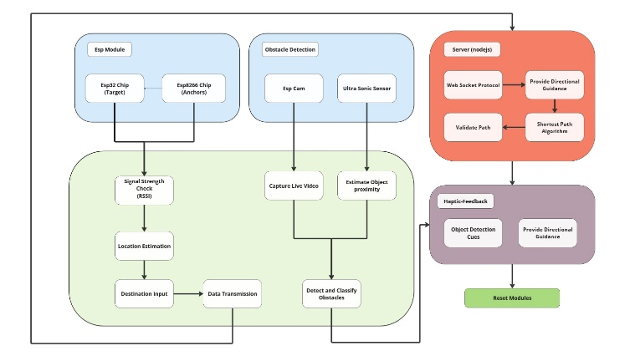
PROPOSED SYSTEM(2/5)
System Architecture

Slide 13
PROPOSED SYSTEM(3/5)
Advantages of the Proposed System
Real-time & Adaptive Navigation – Continuous path updates using Dijkstra’s algorithm and RSSI-based trilateration for accurate indoor positioning.
Haptic Feedback for Non-Visual Guidance – Intuitive vibration-based cues allow independent navigation without relying on visual assistance.
Object Detection for Safety – ESP32-CAM identifies obstacles in real time, ensuring safe movement.
Low Latency Communication – Socket.IO enables fast, real-time updates for seamless guidance.
Scalable & Cost-Effective – Built with affordable IoT components, adaptable for homes, offices, and public spaces with potential for future AI integration.

Slide 14
Modules Completed
Explain the modules that were completed and explain them in detail.
Obstacle Detection: Obstacle detection was implemented using YOLOv8, which enabled real-time identification of objects like walls, furniture, and other obstacles. The model provided fast and accurate detection, ensuring timely alerts for visually impaired users, enhancing safe navigation.

Slide 15
Results and Discussion (1/3)
*For Modules 1/2/3 (how may ever completed), its respective Screenshots must be attached here and explain it.*
*Explain how to proceed with next modules and what output you will achieve*

Slide 16
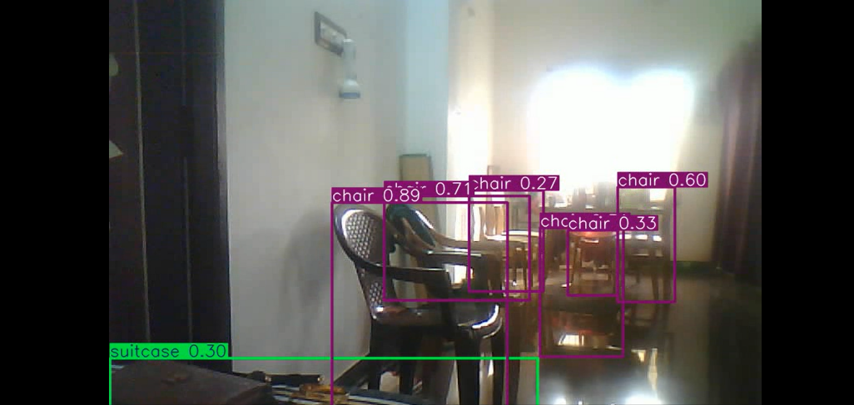
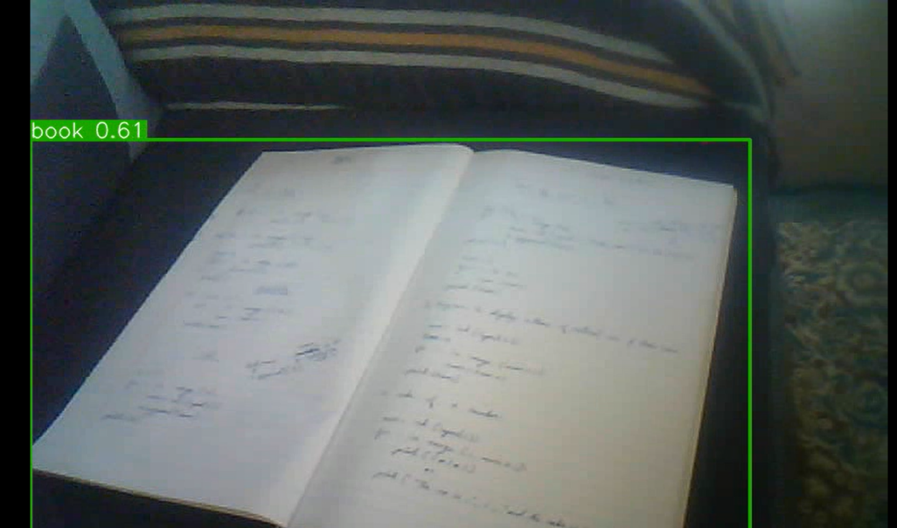
Results and Discussion (2/3)
ESP32-CAM Object Detection: Using the ESP32-CAM, the system successfully detected various objects in the indoor environment, including a person, chair, couch, cell phone, and mouse.
Object Detection Accuracy: The ESP32-CAM demonstrated effective real-time object detection, accurately identifying objects based on pre-trained models.

Slide 17
CONCLUSION
In conclusion, the proposed system provides a sensible solution to mobility problems in the indoor environment of visually impaired people. In summary, it acts as an extended navigational aid with its localization, pathfinding, and real-time feedback capabilities. Future studies on identified issues, implementation of advanced technologies for obstacle detection, and extension of the system for outdoor applications could enhance accessibility further.

Slide 18
REFERENCES
Cheraghi, S. A., V. Namboodiri and L. Walker, "GuideBeacon: Beacon-based indoor wayfinding for the blind, visually impaired, and disoriented," 2017 IEEE International Conference on Pervasive Computing and Communications (PerCom), Kona, HI, USA, 2017, pp. 121-130, doi: 10.1109/PERCOM.2017.7917858.
Dissanayake, D. M. L. V., R. G. M. D. R. P. Rajapaksha, U. P. Prabhashawara, S. A. D. S. P. Solanga and J. A. D. C. A. Jayakody, "Navigate-Me: Secure voice authenticated indoor navigation system for blind individuals," 2021 21st International Conference on Advances in ICT for Emerging Regions (ICter), Colombo, Sri Lanka, 2021, pp. 219-224, doi: 10.1109/ICter53630.2021.9774790.
Dissanayake, D. M. L. V., R. G. M. D. R. P. Rajapaksha, U. P. Prabhashawara, S. A. D. S. P. Solanga and J. A. D. C. Anuradha Jayakody, "Guide-Me: Voice authenticated indoor user guidance system," 2021 IEEE 12th Annual Ubiquitous Computing, Electronics & Mobile Communication Conference (UEMCON), New York, NY, USA, 2021, pp. 0509-0514, doi: 10.1109/UEMCON53757.2021.9666733.
Ishihara, T., J. Vongkulbhisal, K. M. Kitani and C. Asakawa, "Beacon-Guided Structure from Motion for Smartphone-Based Navigation," 2017 IEEE Winter Conference on Applications of Computer Vision (WACV), Santa Rosa, CA, USA, 2017, pp. 769-777, doi: 10.1109/WACV.2017.91.
Joseph, S. L., Chucai Yi, Jizhong Xiao, YingLi Tian and Fei Yan, "Visual semantic parameterization - To enhance blind user perception for indoor navigation," 2013 IEEE International Conference on Multimedia and Expo Workshops (ICMEW), San Jose, CA, 2013, pp. 1-6, doi: 10.1109/ICMEW.2013.6618325.

Slide 19
REFERENCES
Keryakos, Y., Y. B. Issa, M. Salomon and A. Makhouly, "Introducing the Concept of a Hybrid Navigation System Adapted to Blind Users for Optimal Stress-free Indoor and Outdoor Mobility," 2024 International Wireless Communications and Mobile Computing (IWCMC), Ayia Napa, Cyprus, 2024, pp. 1129-1134, doi: 10.1109/IWCMC61514.2024.10592407.
Kumar, S. Mohan, V. Vishnudas Nemane, R. Raman, N. Latha and J. Manojbhai Shah, "IoT-BLE Based Indoor Navigation for Visually Impaired People," 2023 Second International Conference On Smart Technologies For Smart Nation (SmartTechCon), Singapore, Singapore, 2023, pp. 444-448, doi: 10.1109/SmartTechCon57526.2023.10391662.
Li, B. et al., "Vision-Based Mobile Indoor Assistive Navigation Aid for Blind People," IEEE Transactions on Mobile Computing, vol. 18, no. 3, pp. 702-714, 1 March 2019, doi: 10.1109/TMC.2018.2842751.
Tian, L., Y. Tian and C. Yi, "Detecting good quality frames in videos captured by a wearable camera for blind navigation," 2013 IEEE International Conference on Bioinformatics and Biomedicine, Shanghai, China, 2013, pp. 334-337, doi: 10.1109/BIBM.2013.6732513.
Ye, W., N. He, J. Wang and X. Yuan, "A Navigation System for Guiding Blind People in Indoor and Outdoor," 2023 International Conference on Computer Science and Automation Technology (CSAT), Shanghai, China, 2023, pp. 20-24, doi: 10.1109/CSAT61646.2023.00015

Slide 20
THANK YOU
We thank God, Our Department, Guide, Panel Members, Supportive Professors and all Technical and non Technical staff who helped us in our Project.

